Slide 1
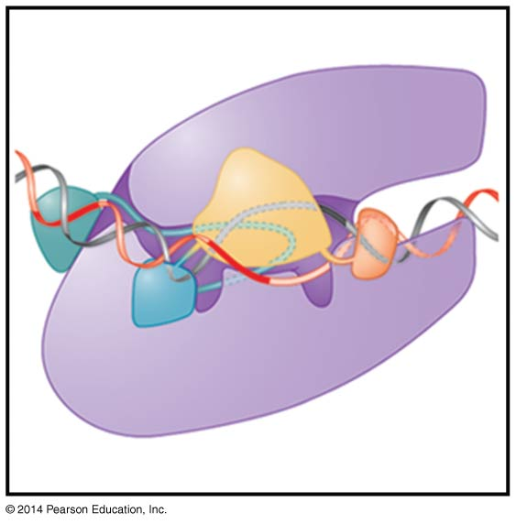
Mechanisms of Transcription
BT 451
Chapter 13

Slide 2
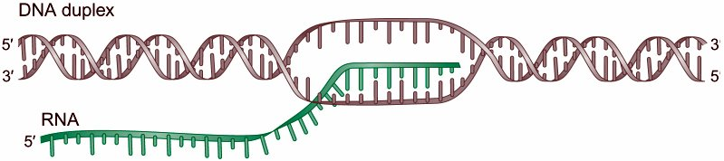
RNA transcription is chemically and enzymatically similar to DNA replication = both involve enzymes that synthesize a new nucleotide strand complementary to a DNA template strand
But:
New strand made of ribonucleotides:
RNA polymerase does not require a primer (free 3’OH)
RNA product does not remain base-paired to template – displacement is critical to produce protein, multiple transcripts at 1 time from the same gene

Slide 3
RNA Polymerase
RNA polymerases are generally multisubunit proteins (not viral or organellar)
Prokaryotes have a single RNA polymerase.
Eukaryotes have 3 RNA polymerases:
Pol I transcribes large ribosomal precursor
Pol II transcribes most genes
Pol III transcribes tRNA genes, snRNA genes and 5S rRNA gene
Pol IV and Pol V: These are found only in plants, where they transcribe small interfering RNAs involved in transcriptional silencing.

Slide 4
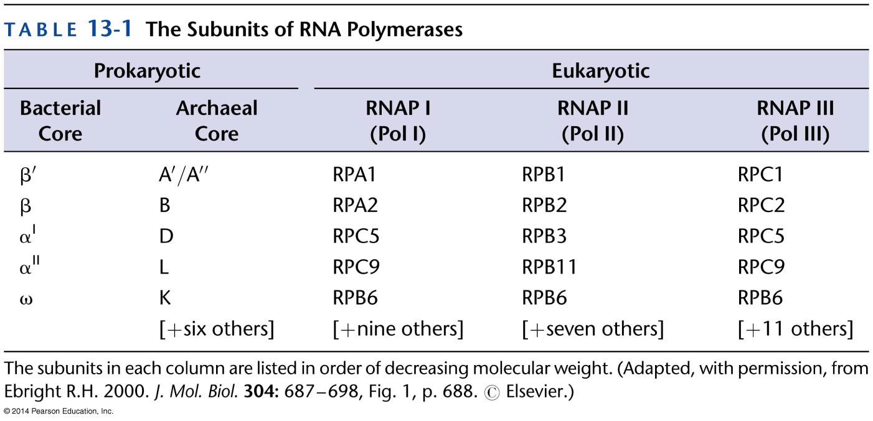
RNA Polymerase
Homologous
subunits
Bacterial RNA polymerase core enzyme can synth. RNA and is composed of 2x α, β, β’ and ω.

Slide 5
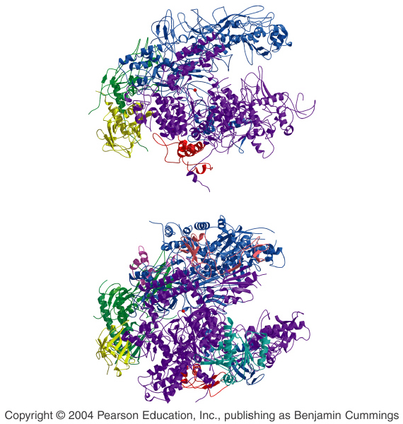
Bacterial and Eukaryotic RNA Polymerase
Bacteria
Structure is similar to yeast Pol II – particularly in functional regions
Structure is more similar than sequence
Yeast

Slide 6
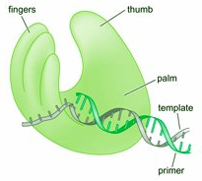
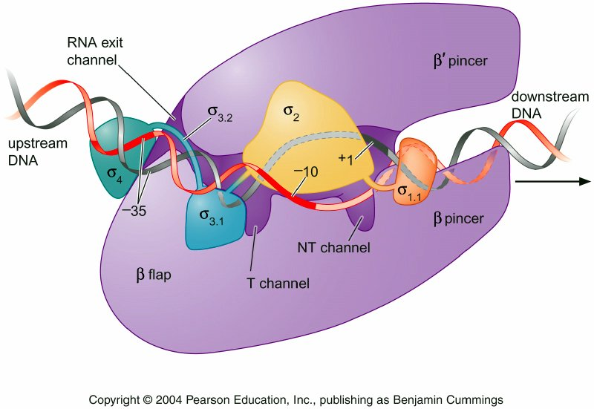
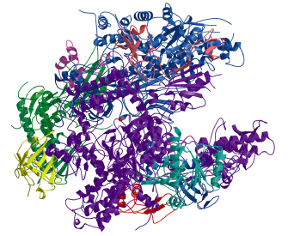
Bacterial and Eukaryotic RNA Polymerase
DNA
polymerase
Shape is claw-like, similar to “hand” model of DNA polymerase
Active center cleft binds two Mg2+ ions - similar to DNA polymerase.
RNA
polymerase

Slide 7
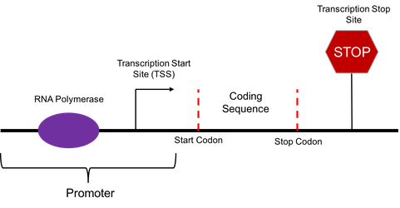
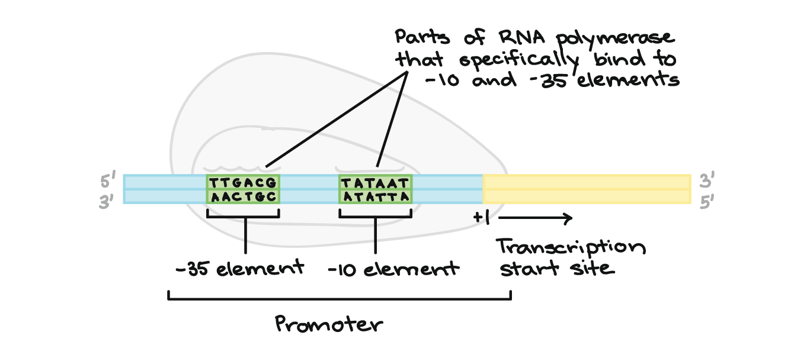
Promoter sequences

Slide 8
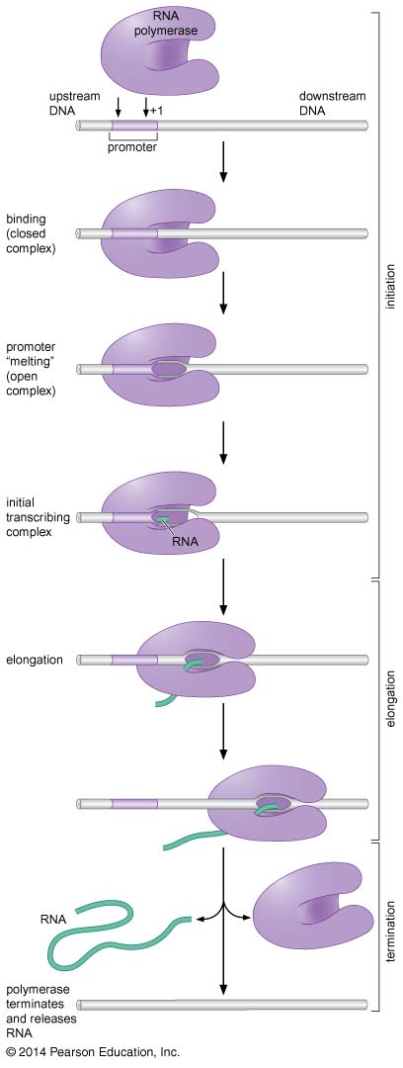
Transcription
Transcription proceeds in steps: Initiation, Elongation and Termination
Initiation = RNA pol binds to sp. DNA seq. – promoter – in sp. orientation
Promoter-pol complex undergoes structural changes, bubble of DNA unwinds - transcription bubble
Transcription occurs only 5’ to 3’ and only one DNA strand is copied
Choice of promoter determines which strand is copied = regulation
Initiation determines what genes are transcribed where and when

Slide 9
Elongation = after ~10 bases have been transcribed pol shifts to elongation phase
Polymerase undergoes further structural changes
DNA is opened and reclosed, RNA is transcribed and proofread and dissociated from DNA – all from one enzyme (in contrast to replication)

Slide 10
Termination = at end of gene transcription is stopped
In some cells, there are well- characterized seq.s, in others the process is less clear.

Slide 11
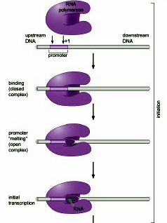
Initiation
Initiation can be broken into a series of steps
The pol binds to the DNA = closed complex, DNA is ds, enzyme is bound to one face of the DNA
2nd step, open complex, DNA strands separate for ~14bp around start site = transcription bubble
Template strand is free, 1st two ribonucleotides enter active site, are aligned to template and joined

Slide 12
Pol now moves along template adding ribonucleotides
Incorporation for first 10 bases is inefficient and often aborted - initial transcribing complex
After ~10 bases, the pol has “escaped” the promoter and forms a stable ternary complex of enzyme, DNA and RNA = elongation

Slide 13
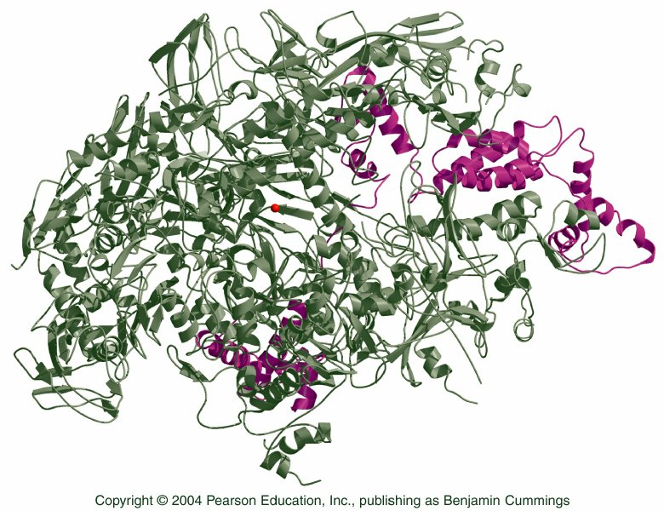
Transcription in Bacteria
in vivo, pol only initiates transcription at promoters
Specificity is a fx of initiation factor, σ
RNA pol and σ = holoenzyme
σ⁷⁰ is predominant factor in E. coli
Core enzyme
σ⁷⁰

Slide 14
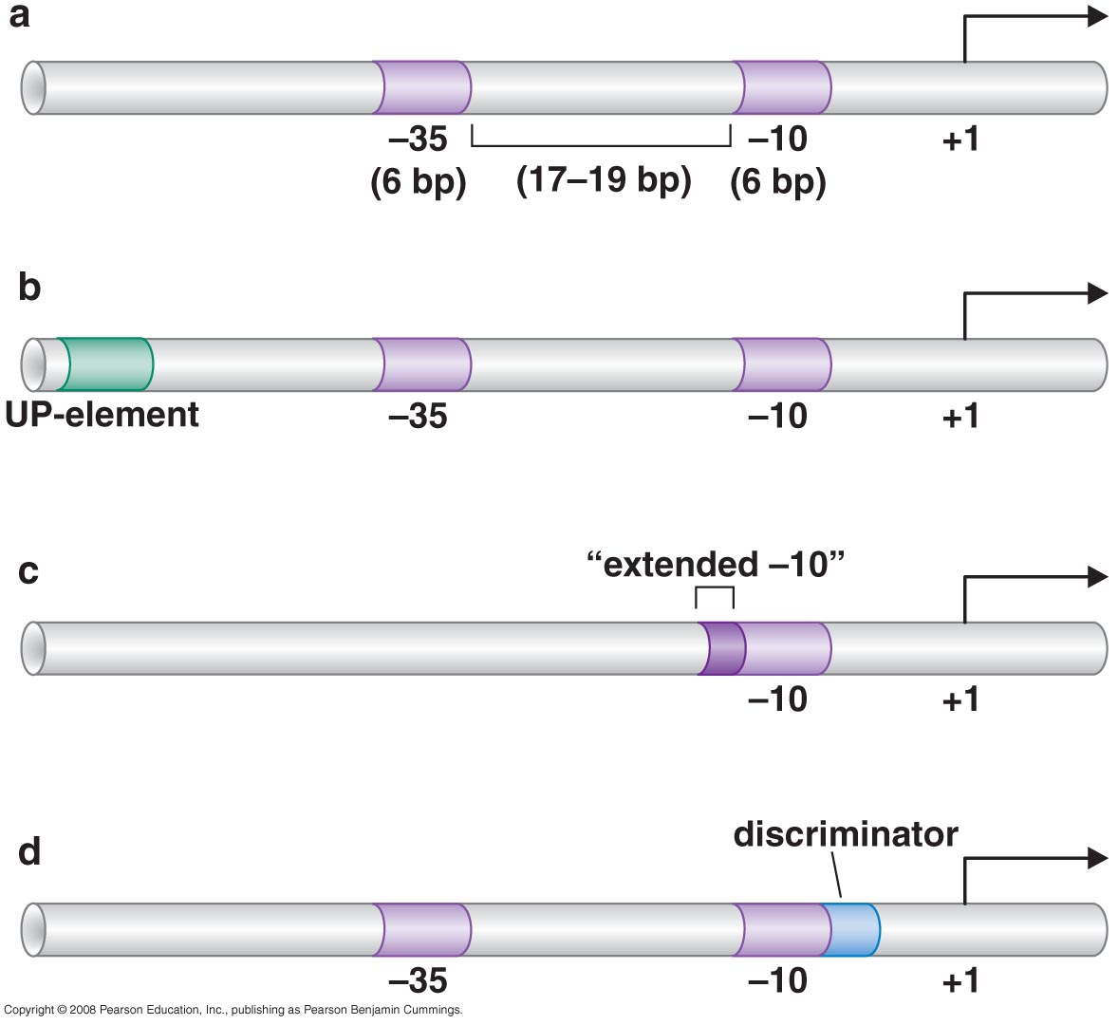
Bacterial Promoters
Promoters recognized by σ⁷⁰ have two conserved seq. each of 6 nucleotides, -10 and -35 elements (beginning of RNA chain is +1)
-10 and -35 seq. are not identical - consensus sequence, and spacing

Slide 15
Promoters are heterogeneous, some stronger than others
Promoters closer to consensus are generally “stronger” than those w/ poor match – more transcripts per unit time

Slide 16
Some strong promoters (rRNA genes) have an UP-element that provides additional binding between DNA and pol
Another class of σ⁷⁰ promoter lacks the -35 element and has an extended -10 element
Element downstream from -10, polymerase binding to this element also influences stability of enzyme/promoter (discriminator element)

Slide 17
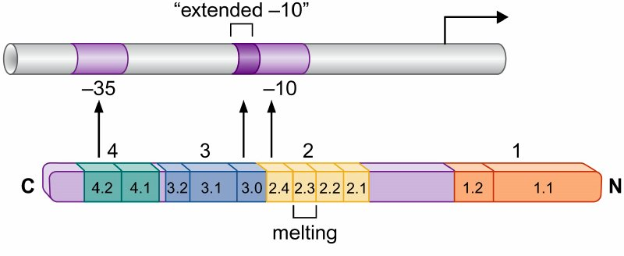
Bacterial Promoters
σ⁷⁰ factor has 4 regions:
Regions 2 and 4 recognize the -10 and -35 elements (respectively)
Region 4 : 2 helices, helix-turn-helix, one helix inserts into top of major groove, other helix contacts DNA backbone

Slide 18
Bacterial Promoters
Region 2, also α helix, and -10 element interactions more complicated
-10 region is site of initiation of DNA melting in transition from closed to open complex
Helix contains aromatic amino acids that stabilize melted strands through interaction w/ nontemplate strand - similar to base-stacking by SSBs in replication

Slide 19
If present, extended -10 element is recognized by region 3 helix contacting 2bp in element
The discriminator is recognized by region 1.2
UP-element is not recognized by σ, instead by carboxyl terminal domain of α subunit = αCTD

Slide 20
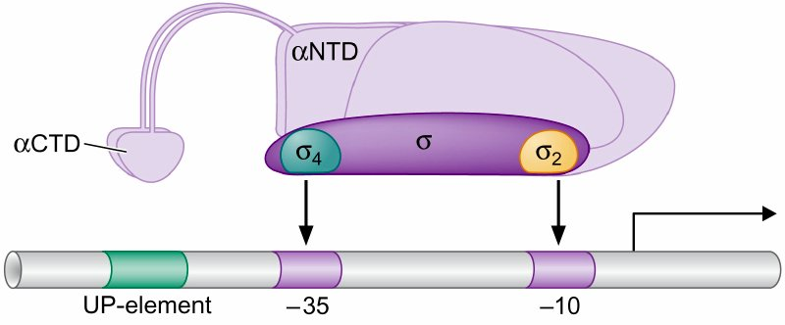
α and σ subunits of RNA polymerase
αCTD is connected to αNTD (amino terminus) by flexible linker – can reach upstream element
Spacing and location (surface) of DNA-binding regions makes DNA-protein interactions possible.
Region 3.2, σ_{3/4} linker, maintains spacing between σ₂ and σ₄

Slide 21
Transition to Open Complex
Initial binding of pol to promoter leaves DNA ds
Transition from closed to open complex involves structural changes in polymerase, and melting of -11 to +2 DNA
For σ⁷⁰-bearing pol transition, isomerization, does not require ATP
Isomerization is essentially irreversible, formation of closed complex is readily reversible

Slide 22
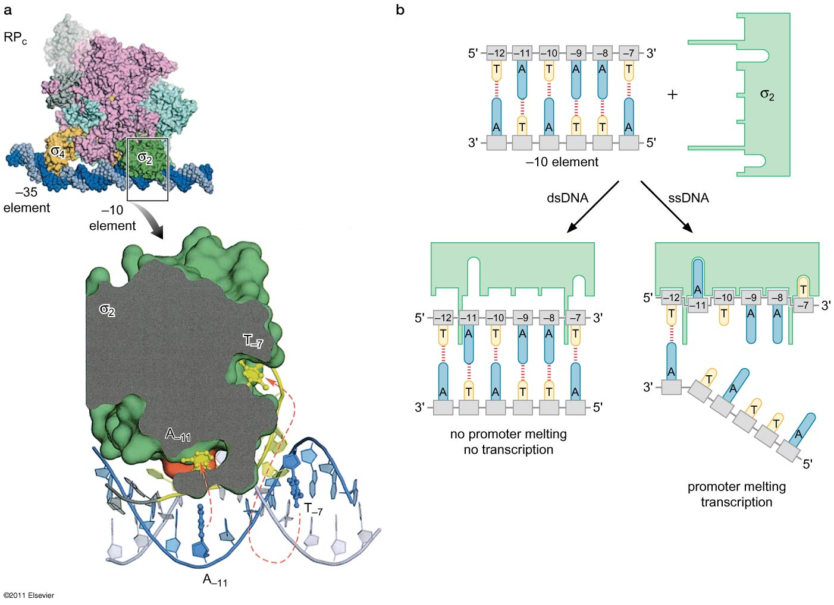
Recognition and melting of the –10 elements by σ region 2.
Notes:
22
Figure 13-8

Slide 23
Structure of RNA pol
Channel runs between “pincers”
Active site is made up of regions of β and β’ subunits and found w/in active site cleft
There are 5 channels into enzyme:
1) NTP-uptake channel allows ribonucleotides into active center
2) RNA-exit channel allows growing chain to leave enzyme during elongation

Slide 24
Remaining 3 channels allow DNA in and out
Downstream dsDNA enters active center cleft through downstream DNA channel (3)
w/in active center cleft DNA strands separate at +3, nontemplate strand exits through nontemplate-strand (NT) channel (4)
Template strand follows through active cleft and exits through template strand (T) channel (5), dsDNA reforms
at -11

Slide 25
w/ transition to open complex, pincers clamp down on DNA and there is a major shift in the position of N-terminal region of σ
σ region 1.1 shifts ~50 angstroms and moves from blocking path into enzyme active site cleft to outside of enzyme allowing DNA access to cleft
Region 1.1 is, like DNA, negatively charged (molecular mimic), space in cleft occupied by either 1.1 or DNA is positively charged
σ region 1.1

Slide 26
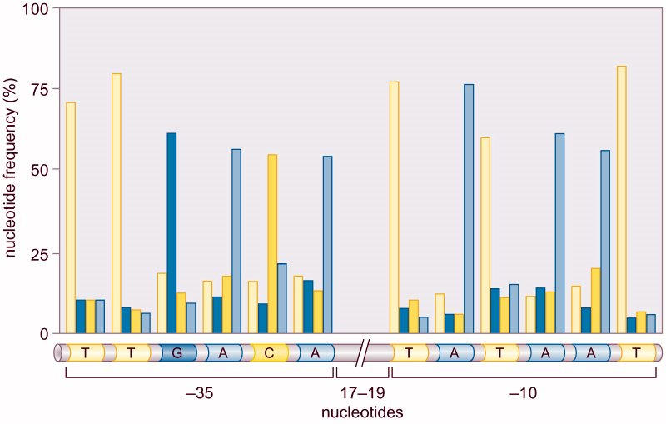
Consensus Sequence
A consensus sequence is simply the most common bases at a given site across all sequences compared
The consensus sequence itself may never (but can) actually occur

Slide 27
Initiation
RNA pol does not require a free 3’ OH supplying primer
It does require first ribonucleotide be in specific orientation for polymerization to occur
Pol specifically interacts w/ first base, almost always an A, to position it in cleft
Interactions appear to involve multiple parts of holoenzyme, including part of sigma, σ_{3/4}, mutation of sigma alters specificity

Slide 28
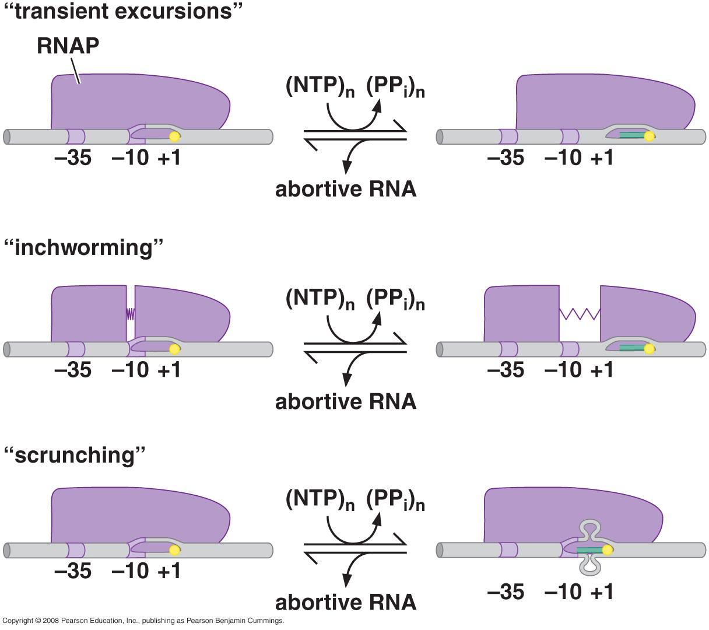
Abortive Initiation
RNA pol synthesizes short RNA molecules <10 nucleotides that are released and synthesis begins again = abortive initiation
3 models for DNA translocation during initial cycles of transcription
1) Transient excursion - short cycles of forward and reverse translocation synthesizing short fragments

Slide 29
RNA pol synthesizes short RNA molecules <10 nucleotides that are released and synthesis begins again = abortive initiation
3 models for DNA translocation during initial cylces of transcription
2) Inchworming - flexible element in polymerase allows front of enzyme to move downstream synthesizing before retracting

Slide 30
RNA pol synthesizes short RNA molecules <10 nucleotides that are released and synthesis begins again = abortive initiation
3 models for DNA translocation during initial cylces of transcription
3) Scrunching - polymerase is stationary and DNA is pulled into polymerase and held as single-stranded bulges - currently the most accepted model.

Slide 31
More than ~10 bases cannot be accommodated w/in pol and must exit through RNA exit channel
Promoter escape involves breaking of all contact between pol and regulatory DNA elements.
Reason for abortive initiation is not clear, appears to involve sigma region 3.2 (σ_{3/4} linker), which must be ejected for synth of >10 nucleotide fragments
σ region 3.2

Slide 32
Region 3.2 (σ_{3/4} linker) is a molecular mimic filling the RNA exit channel.
Scrunching stores energy - bubble expands to 22-24 nucleotides. Collapse to 12-14 provides energy to break polymerase-promoter and core-σ interactions.
σ region 3.2

Slide 33
Elongation
During elongation DNA passes through enzyme in similar manner as in open complex
Only 8 or 9 nucleotides of growing RNA chain remain paired w/ template, the remainder exit through RNA exit channel.

Slide 34
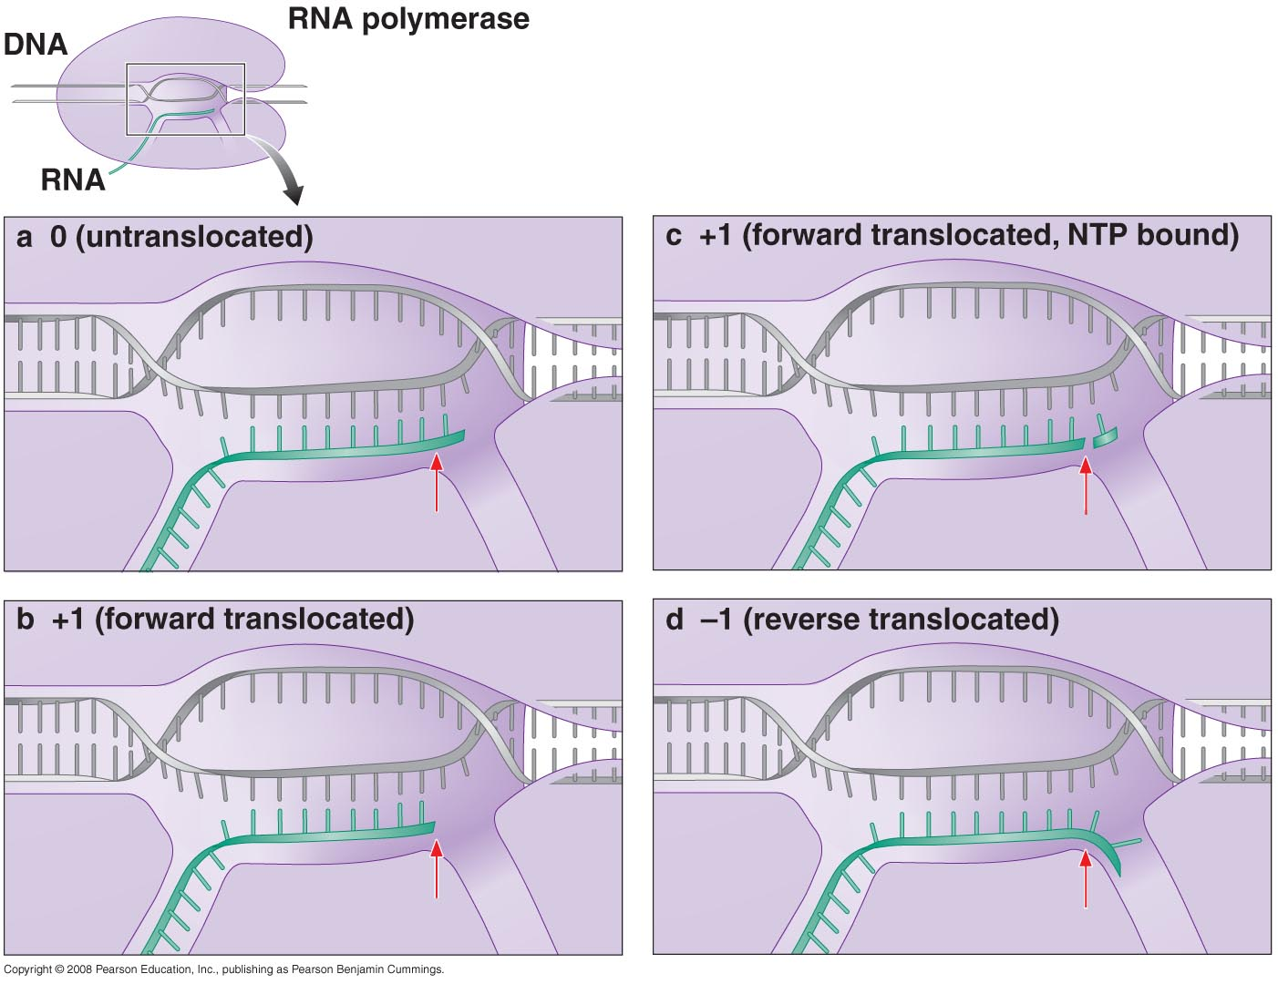
During elongation DNA passes through enzyme in similar manner as in open complex
Only 8 or 9 nucleotides of growing RNA chain remain paired w/ template, the remainder exit through RNA exit channel.

Slide 35
Transcript Editing
RNA pol carries out two proofreading functions
1- Pyrophosphorolytic editing = simple back reaction catalyzing the removal of mispairs ribonucleotide - reincorporation of PPi
Correct or incorrect nucleotides can be removed, but incorrect removed more frequently

Slide 36
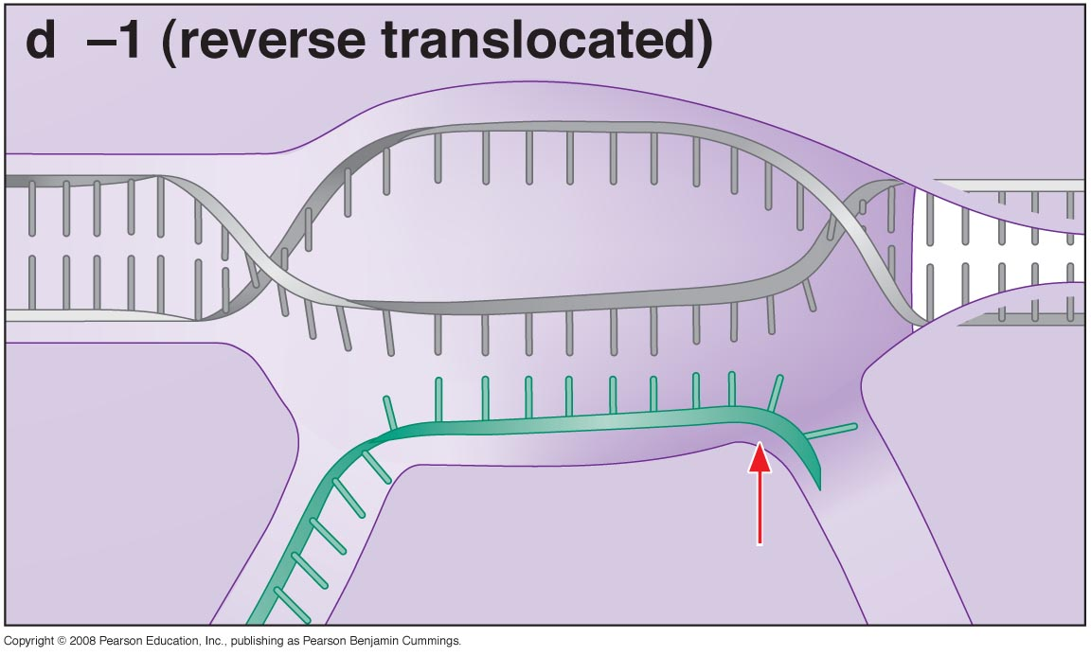
2- Hydrolytic Editing = polymerase backtracks one or more nucleotides and cleaves RNA product
Hydrolytic editing is stimulated by Gre factors which also generally stimulate elongation (eukaryotic TFIIS)
Nus proteins also stimulate elongation and termination

Slide 37
Polymerase removal
Stalled RNA pol - e.g. at damaged DNA - can be removed from DNA strand
The bacterial transcription-repair coupling factor (TRCF) protein removes RNA polymerase and recruits DNA repair enzymes (Uvr(A)BC)) for transcription-coupled DNA repair
TRCF is an ATPase: It binds dsDNA upstream of pol and uses ATPase motor to translocate along DNA
Encountering stalled pol can either restart or removed pol from DNA.

Slide 38
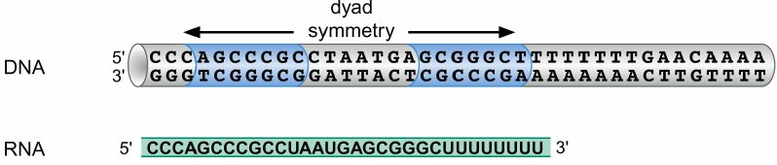
Termination
Terminator sequences trigger polymerase to dissociate from DNA.
Bacteria have Rho-dependent and Rho-Independent terminators
Rho-independent, or intrinsic, terminators consist of an inverted repeat
Sequence of a Rho-independent terminator.

Slide 39
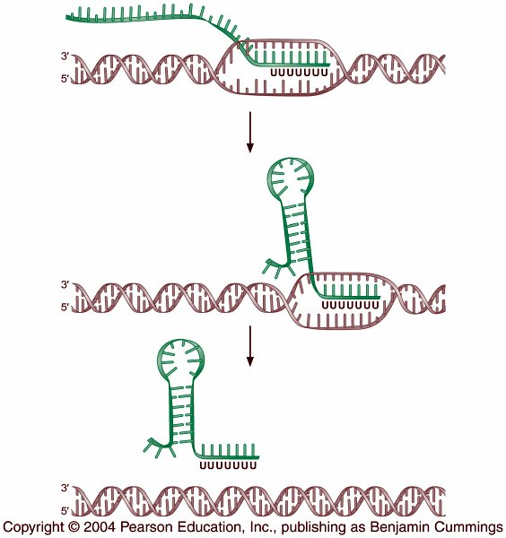
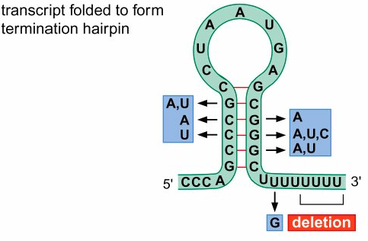
Termination through a Rho-independent terminator.
Intrinsic terminators function in the RNA product.
The transcribed RNA folds on itself, forming a hairpin structure which disturbs the elongation complex.
The hairpin only works when followed by A:U pairs, the weakest of the base pairings.

Slide 40
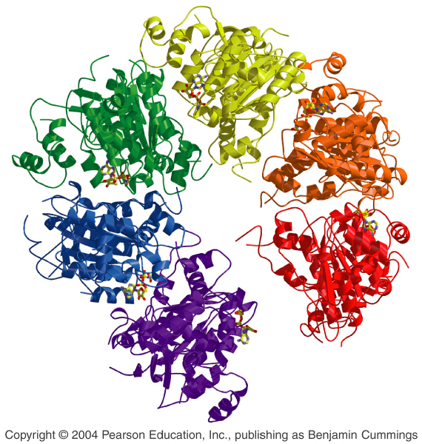
Rho-dependent termination is less well characterized
The Rho factor is a ring-shaped protein w/ 6 identical subunits that binds RNA as it exits the pol
The Rho factor is an ATPase, using energy from ATP to separate the RNA from the template and pol - possibly pushing as in TRCF system (conformational changes)
The Rho transcription termination factor.

Slide 41
There is some seq. sp. in binding (rut sites, `40bp, no 2° structure, C-rich), but less than in intrinsic terminators
Recent studies also have suggested that Rho binds to RNA polymerase throughout the transcription cycle
Rho factors do not bind to transcript that is being translated (coupled in bacteria).

Slide 42
Eukaryotic vs Prokaryotic Transcription
Transcription is similar in both prokaryotes and eukaryotes, but:
Single RNA pol in prokaryotes, 3 in eukaryotes
Several initiation factors, general transcription factors (GTFs) are required, not just a single, σ factor
in vivo, the presence of nucleosomes requires Mediator Complex, additional DNA-binding proteins and chromatin-modifying proteins, for transcription.

Slide 43
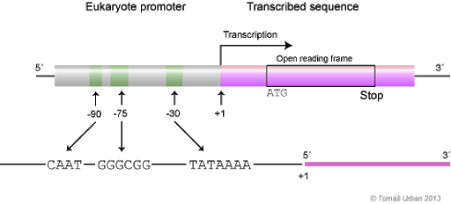
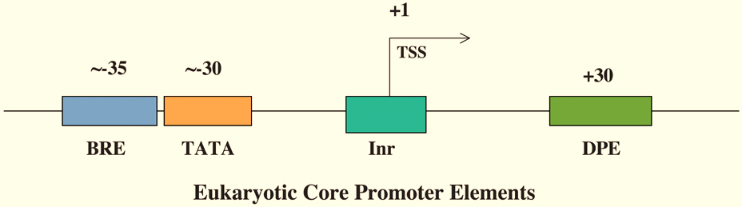

Slide 44
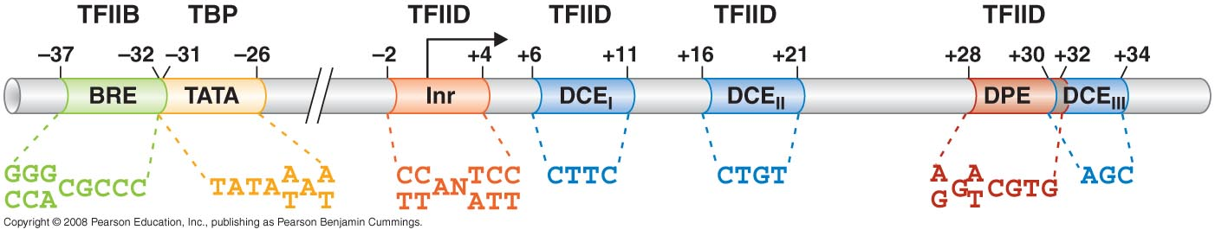
Eukaryotic Transcription
General Transcription Factor
Consensus Sequence
Eukaryotic core promoter = minimal set of seq. elements required for accurate transcription initiation by pol II in vitro
~40-60 nucleotides long, extending either up or downstream of transcription start site, components are 2 or 3 of:
BRE = TFIIB recognition element
TATA element or box
Initiator = Inr
Downstream promoter elements = DPE, DCE, MTE
(DCE: downstream control/core element, MTE: motif ten element)

Slide 45
General Transcription Factor
Consensus Sequence
Other seq. elements, generally upstream of the core, are required for efficient transcription = regulatory sequences:
Promoter proximal elements
Upstream activator sequences (UASs)
Enhancers (activating) and Silencers (repressing elements)
Boundary elements and insulators
All of these bind regulatory proteins (activators and repressors) which help or hinder transcription from the core promoter, can be located 10s to 100s of Kb from core

Slide 46
General Transcription Factor
Consensus Sequence
Preinitiation complex = complete set of general transcription factors and polymerase bound together at promoter
General transcription factors collectively perform function of bacterial σ – bind promoter, melt DNA, escape promoter and begin elongation

Slide 47
General Transcription Factor
Consensus Sequence
Pol II promoters contain a TATA-element, ~30 bp upstream of transcription start site – this is where preinitiation complex formation begins
TATA element is recognized by TFIID multisubunit complex, TBP binds element, associated factors, TAFs affect binding of TBP

Slide 48
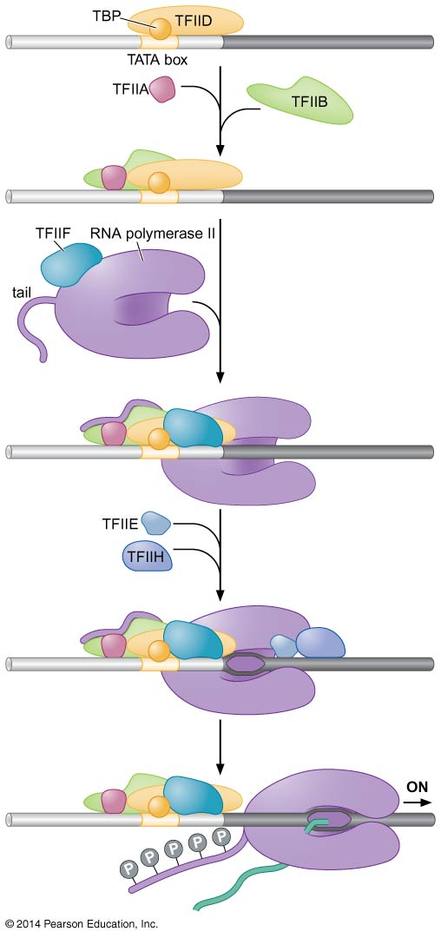
TBP binds and distorts TATA sequence, the complex recruits other transcription factors and the pol
TFIIA, TFIIB, TFIIF bind w/ pol II (w/ mediator complex), then TFIIE and TFIIH bind upstream of pol = preinitiation complex
This is followed by promoter melting, mediated by TFIIH (helicase-like), requiring ATP hydrolysis
Promoter melting is followed by abortive initiation = short transcripts

Slide 49
Promoter escape (end of abortive initiation) requires phosphorylation of RNA pol.
The large subunit of pol II has a C-terminal domain (CTD) containing a series of repeats of Tys-Ser-Pro-Thr-Ser-Pro-Ser, 27 in yeast, 52 in human
Each repeat contains site for phosphorylation, by sp. kinases (including subunit of TFIIH)
Addition of phosphates sheds most general transcription factors, regulation of phosphorylation regulates RNA processing

Slide 50
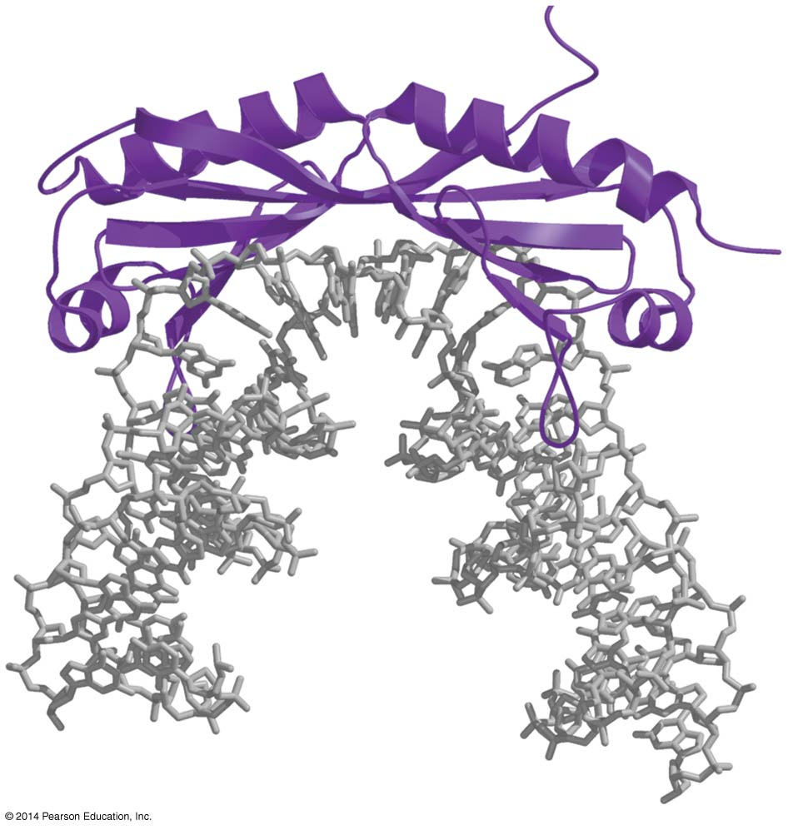
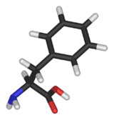
TATA Binding
TBP uses extensive region of β-sheet to recognize minor groove of TATA element
Generally DNA binding proteins use α-helix to bind major groove (e.g. σ-factor)
TBP binding specificity relies of ability of TATA sequence to undergo specific structural distortion
TBP binding causes minor groove to widen to almost flat, and bends DNA by ~80°
This interaction requires few H bonds, specificity is product of phenylalanine side chains intercalcating into DNA – AT rich readily distorted, phosphate backbone interacts w/ β-sheet.
phe

Slide 51
Other transcription factors
Other factors are less well understood, many are multisubunit complexes
TAFs = TBP is associated w/ ~10 TAFs, 2 bind to the initiator element and the downstream promoter element
TAFs have homology to histone proteins and may bind in similar fashion
Another TAF appears to regulate binding of TBP to DNA w/ an inhibitory flap that binds to the DNA binding surface of TBP = molecular mimicry, flap must be displaced for DNA binding

Slide 52
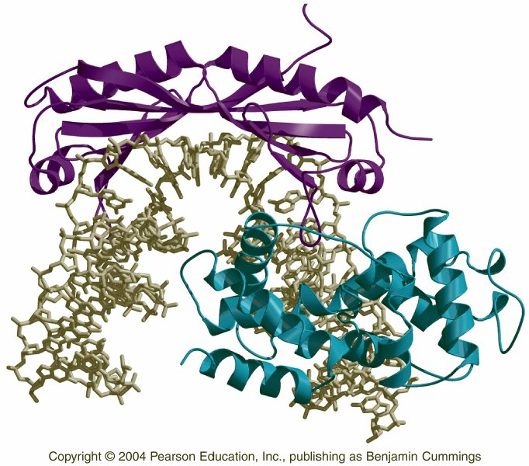
TFIIB, single polypeptide chain, enters preinitiation complex after TBP and interacts w/ both DNA and TBP
Base-specific interactions w/ major groove upstream, and minor groove downstream, of TATA element
The asymmetric binding of TFIIB to the TBP-TATA complex accounts for the asymmetry in the rest of the preinitiation complex and unidirectional transcription
TFIIB bridges between TATA-bound TBP and RNA pol, inserts into RNA exit of RNA pol analogous to σ 3/4 linker
TFIIB–TBP–promoter complex.

Slide 53
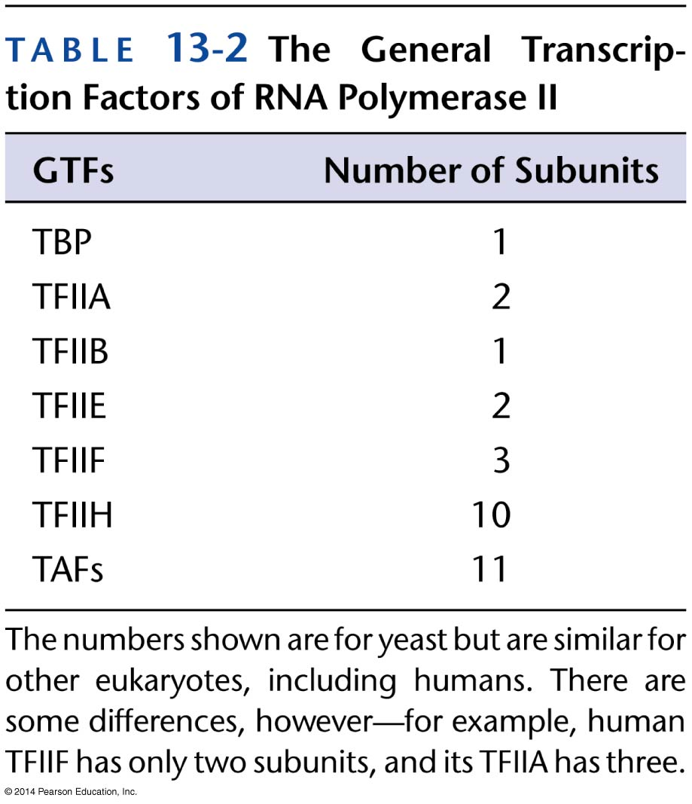
TFIIF : 2 subunit factor associates w/ Pol II, binding of Pol II – TFIIF stabilizes DNA-TBP-TFIIB complex and is required before recruitment of TFIIE and TFIIH to pre-initiation complex
TFIIE, 2 subunits, binds to complex and recruits TFIIH
TFIIH, largest factor w/ 10 subunits, controls ATP-dependent transition of pre-initiation complex to open complex. 2 subunits are ATPases, another protein kinase w/ role in promoter melting and escape. ATPases are involved in nucleotide excision repair.

Slide 54
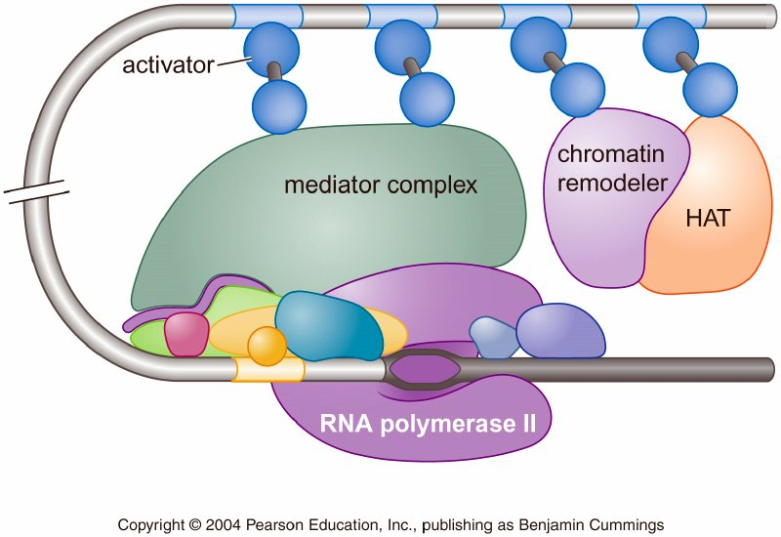
Transcription in vivo
Eukaryotic DNA is packaged into nucleosomes and chromatin
in vivo transcription requires proteins to interact w/ packaged DNA.
Activators recruit pol to promoter, often through mediator complex interacting w/ CTD tail
Deletion of individual subunits of mediator leads to loss of expression in subset of total pattern
Activators, nucleosome modifiers and remodelers and mediator subunits are gene-specific, tissue-specific, condition specific, etc

Slide 55
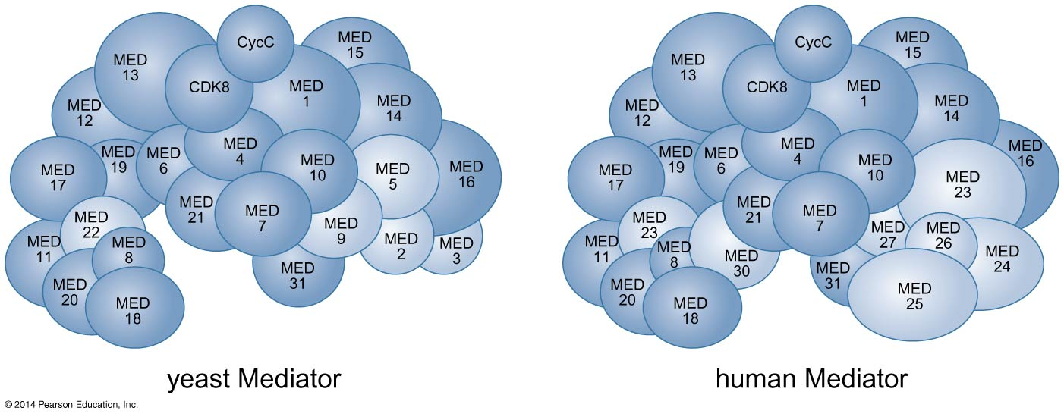
Mediator Complex
Mediator complexes contain 20+ subunits (only 7 show sig. homology between yeast and human)
Only one, Srb4/Med17, is essential for in vivo transcription of all genes
Mediators are large, w/ generally conserved shape.

Slide 56
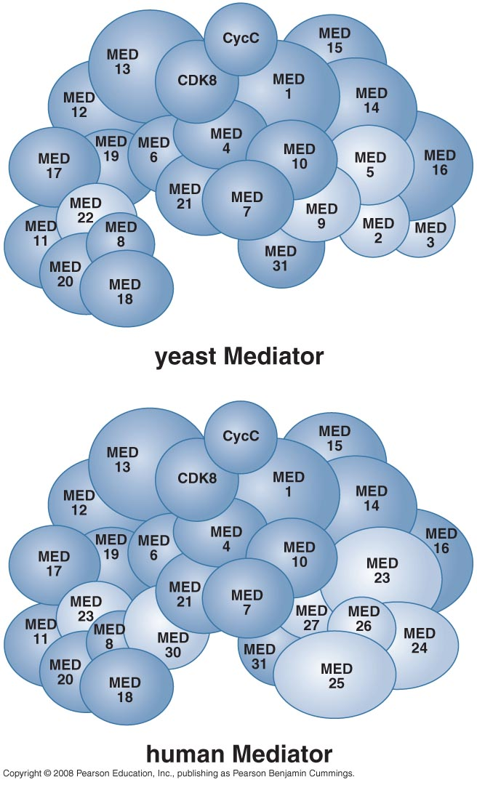
Mediators appear to be modular, w/ different components in different tissues, interacting w/ different genes (and regulators).

Slide 57
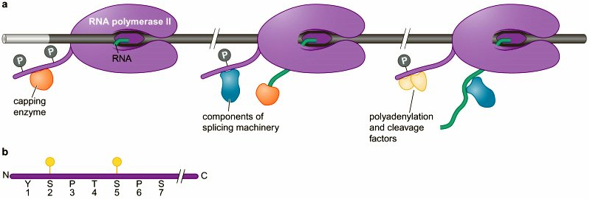
Elongation
RNA pol sheds initiation factors and recruits new elongation factors in transition to elongation
Elongation factors, and RNA processing factors, are recruited to (phosphorylated) CTD (carboxy-terminal domain) of Pol II
Long (~7x the rest of the enzyme) CTD lies near RNA exit channel of pol – tail binds factors and delivers them to newly synthesized RNA.

Slide 58
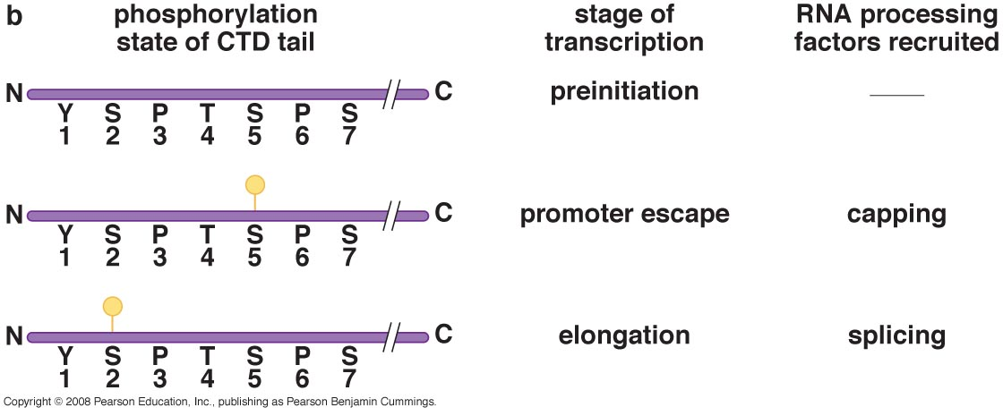
The kinase P-TEFb binds to CTD and phosphorylates position 2 serine in repeat – phosphorylation correlates w/ transition to elongation.
P-TEFb also activates (phosphorylates) hSPT5 an elongation factor, and recruits TAT-SF1 another elongation factor.

Slide 59
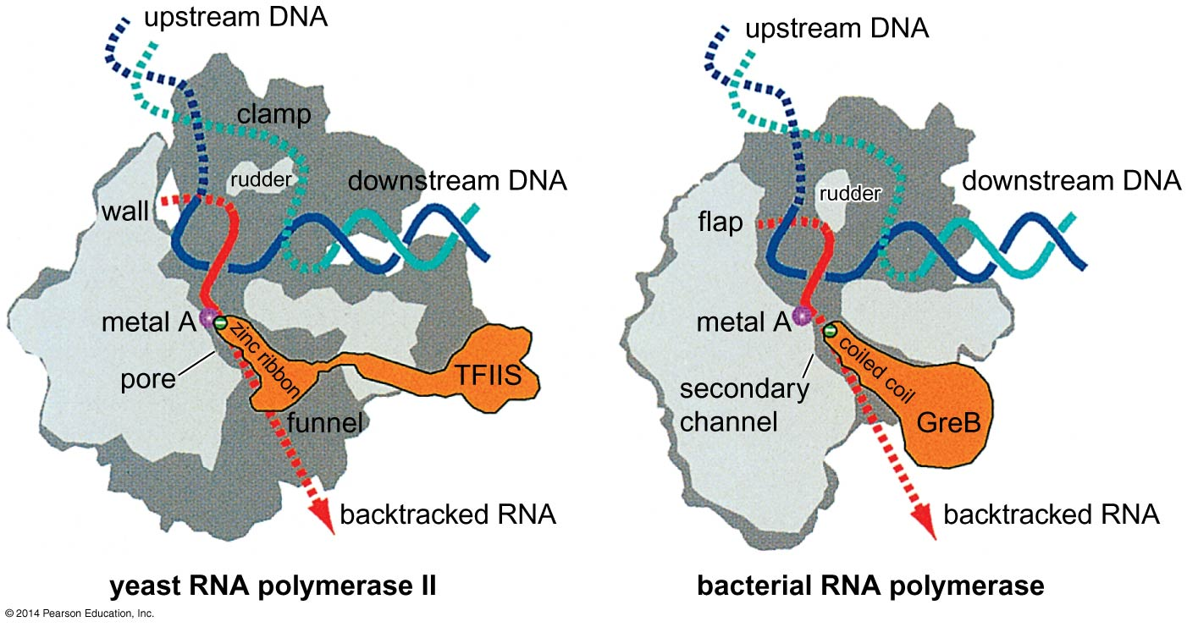
TFIIS, an elongation factor, limits the time that pol pauses during transcription, rate of transcription is not constant – but pauses are shorter in the presence of TFIIS
TFIIS also contributes to proofreading by polymerase through an alternative route = RNAse activity sep. from active site, comparable to hydrolytic editing stimulated by Gre factors in bacteria - analogous to Gre factors

Slide 60
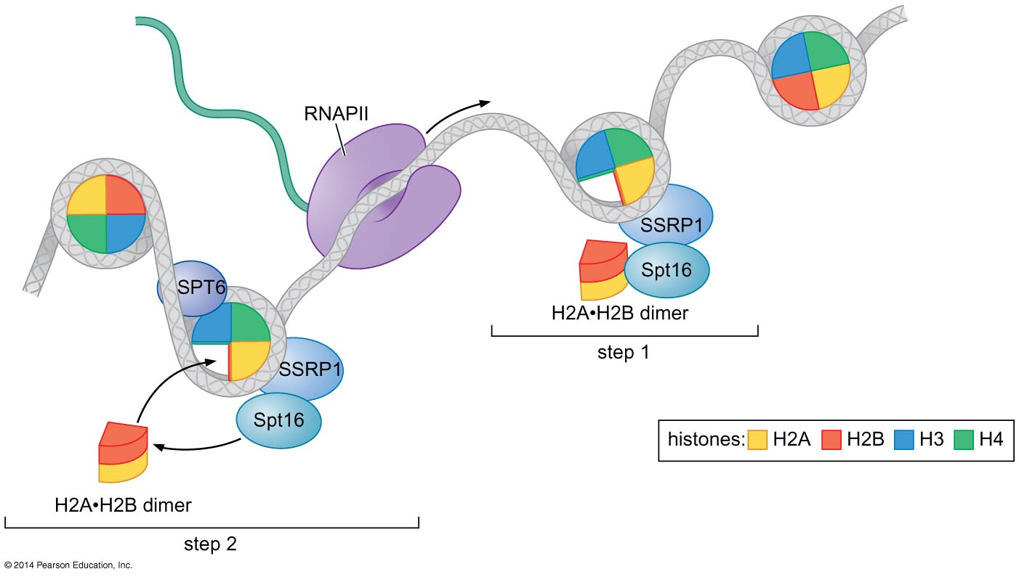
Elongation and Nucleosmes
RNA transcription takes place in the presence of histones - impede transcription
FACT (facilitates chromatin transcription) is a highly conserved heterodimer of Spt16 and SSRP1.

Slide 61
Spt16 binds to H2A-H2B dimer, SSRP1 toH3/H4 tetramer
FACT dismantels and reassembles histones by removing H2A-H2B dimers - it has a histone chaperone activity.

Slide 62
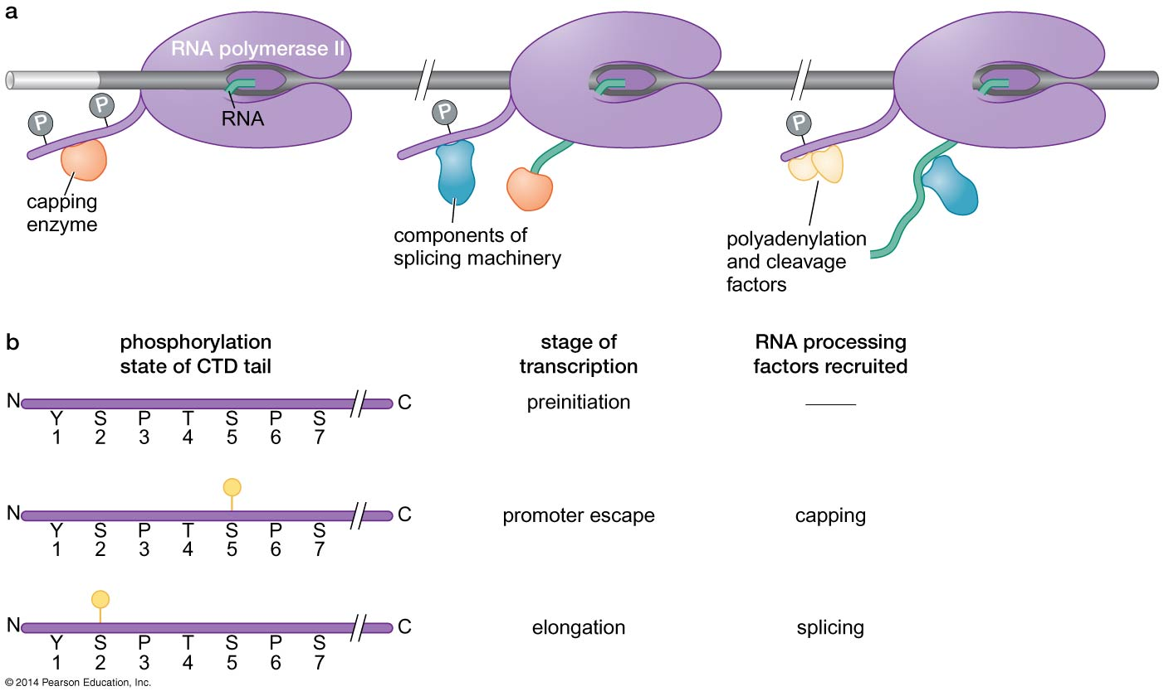
Elongation and RNA processing
RNA is processed during transcription, 5’ cap, splicing and polyadenylation of 3’ end – need coordinated activity
Elogation factor hSPT5 recruits and stimulates 5’ capping enzyme - to CTD phosphorylated at serine 5
Elongation factor TAT-SF1 recruits components of splicing machinery to CTD phosphorylated at serine 2

Slide 63
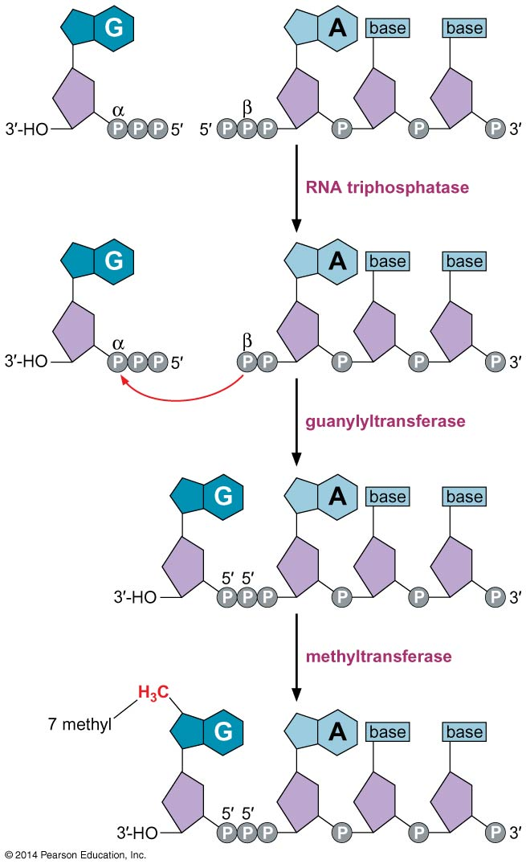
RNA Capping
Capping involves the addition of methylated guanine in 5’ to 5’ linkage to 5’ end of the RNA, done when RNA is ~20 nucleotides long - transition from initiation to elongation
Cap is created in 3 enzymatic steps:
1) Phosphate is removed from 5’ end of transcript
2) GMP is added
3) Nucleotide is modified by addition of methyl group

Slide 64
After capping CTD Ser5 is dephosphorylated and capping machinery dissociates
Phosphorylation of Ser2 recruits splicing machinery

Slide 65
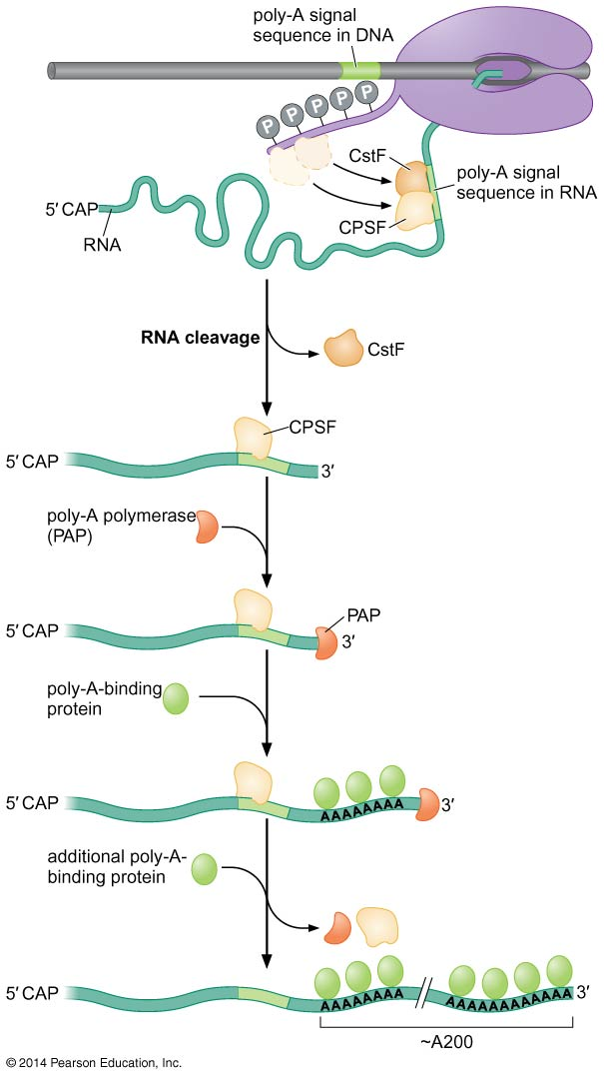
PolyA Tail addition
Addition of polyA tail and termination are linked
At end of gene pol transcribes seq. that trigger the transfer of polyadenylation enzymes to RNA leading to 3 events:
1) cleavage of message
2) addition of adenine residues to 3’ end
3) termination of transcription by pol

Slide 66
pol CTD carries 2 protein complexes, cleavage and polyadenylation specificity factor (CPSF) and cleavage stimulation factor (CstF)
Once poly-A signal sequences are transcribed, CPSF and CstF bind to message, recruit other proteins, and message is cleaved, then poly-A added.

Slide 67
Specific polymerase, poly-A polymerase (PAP), adds ~ 200 adenines to 3’ end of RNA
Length determined by specific poly-A binding proteins
ATP precursors and chemistry is the same as RNA pol, but no template is required, poly-A tail is unique to RNA Pol II transcripts.
Mature RNA is exported from nucleus

Slide 68
RNA polymerase continues to transcribe RNA after message is cleaved, creating 2nd message
Polyadenylation is required for termination, but connection is unclear.

Slide 69
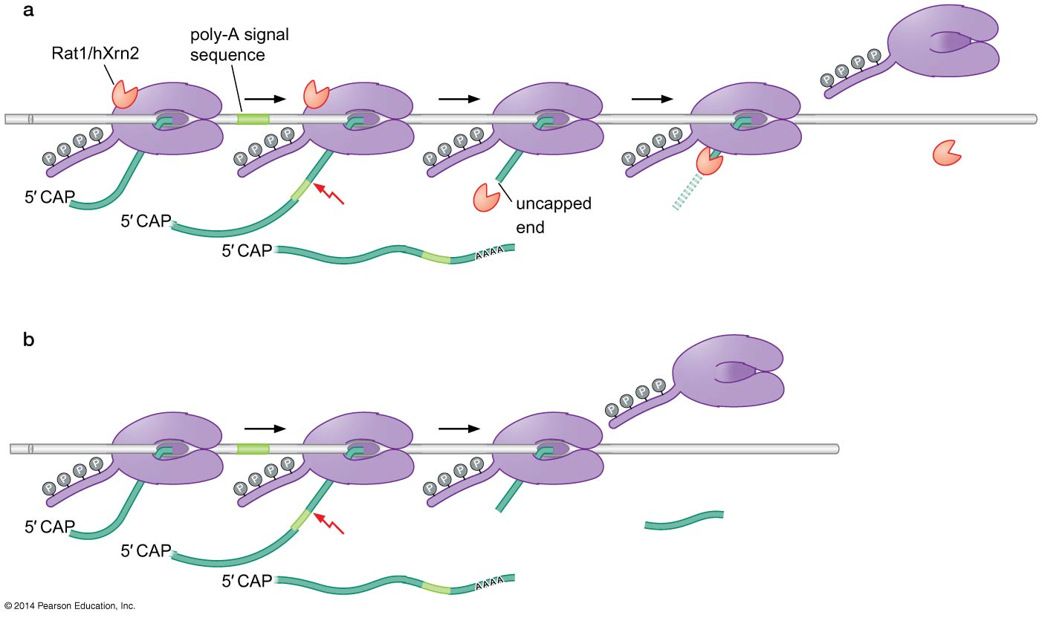
Termination
Termination may result from:
1- Torpedo model - Rat1 (hXrn2) is an Rnase that recognizes uncapped “new” RNA molecule - degrades in 5’ to 3’ direction, catches up to RNA pol and may knock it off template (think Rho dependent termination in bacteria) or pull template out of RNA pol.

Slide 70
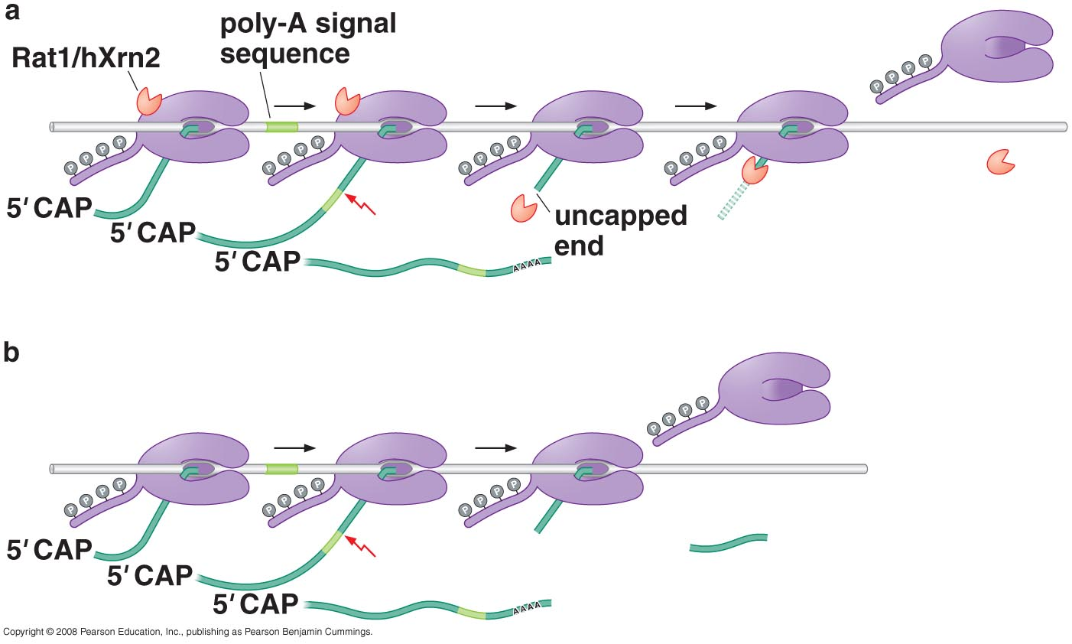
Termination may result from:
2- Allosteric model steric change in pol, possibly linked to polyadenylation and transfer of 3’ processing enzymes to RNA, may reduce pol processivity leading to spontaneous termination

Slide 71
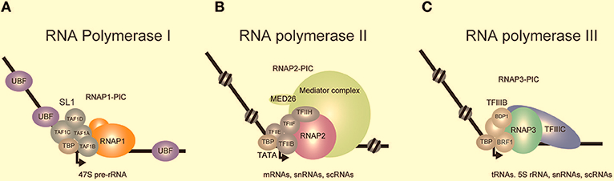
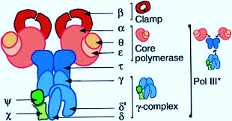
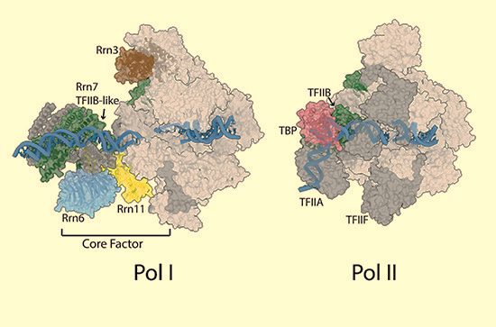
RNA Pol I and III

Slide 72
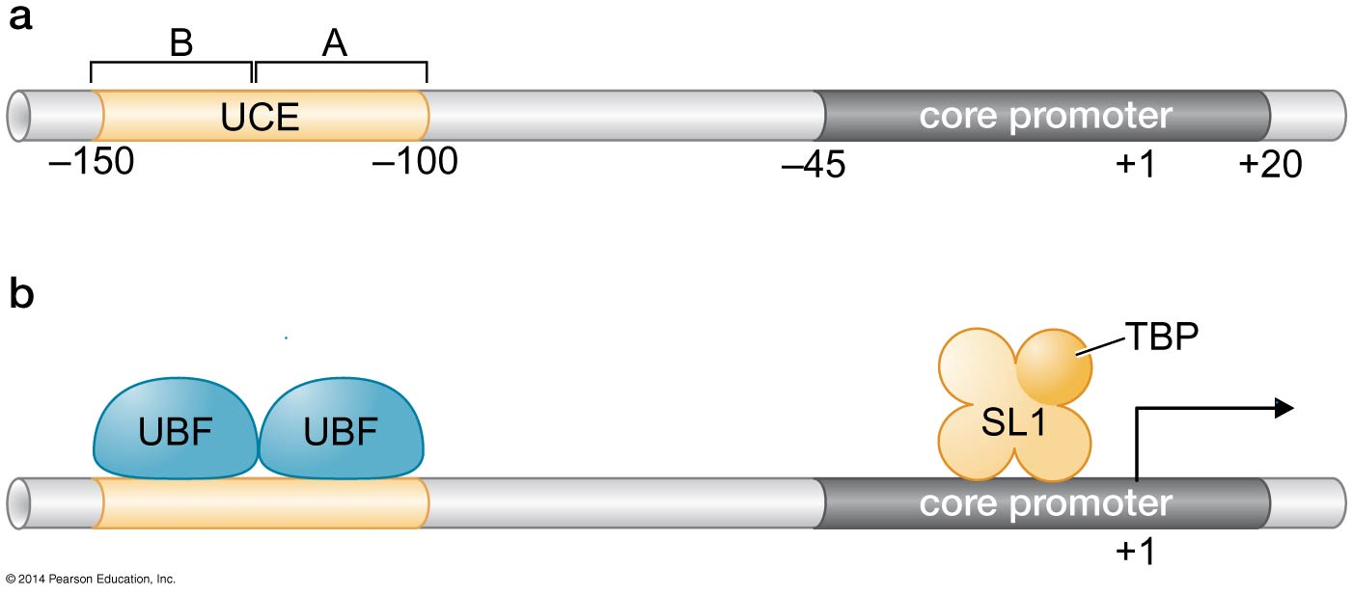
Pol I and III
Pol I and III are related to Pol II and share some subunits
Both initiate transcription from distinct promoters and transcribe distinct genes = specialized RNAs, each also have unique transcription factors
TBP is, however, universal to all eukaryotic RNA pols
Pol I transcribes the rRNA precursor, multiple copy gene expressed more highly than any other gene

Slide 73
Pol I promoter
Pol I promoter has 2 parts, the core element and the upstream control element, UCE
Initiation requires Pol I and 2 other factors, SL1 and UBF
SL1 consists of TBP and 3 TAFs sp. to Pol I transcription
SL1 binds in the presence of UBF and together both recruit Pol I

Slide 74
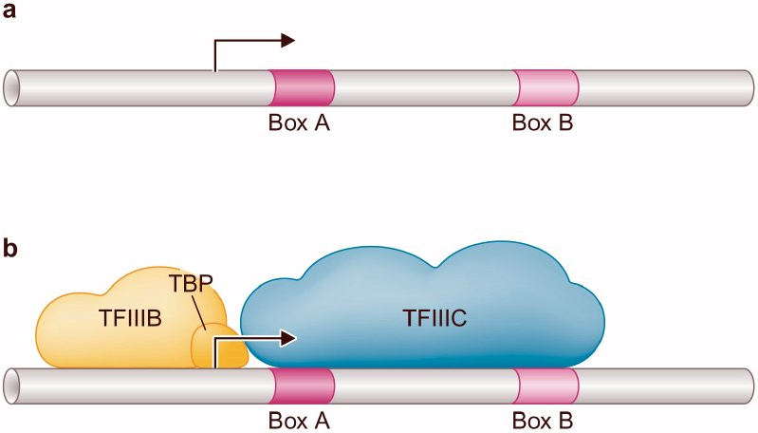
Pol III promoter
Pol III promoters are variable, but generally are located downstream of transcription start site (TSS)
Some Pol III promoters (e.g. tRNA genes) consist of 2 regions, Box A and Box B
Other Pol III promoters ( e.g. 5S RNA gene) consist of Box A and Box C, others contain a TATA element like Pol II
At the tRNA promoter, TFIIIC complex binds and recruits TFIIIB, which recruits Pol III, here TBP complexes w/ TFIIIB

Slide 75
END

